Slide 1
AYUSH SHARMA(2nd YEAR)
POINTERS IN C PROGRAMMING LANGUAGE

Slide 2
CONTENT:
Introduction to Pointers
Declaration And Initialization of Pointers
The ‘&’ And ‘*’ Operator
Pointer Arithmetic
Multiple Pointers
Array of Pointers
Structure Pointers

Slide 3
Introduction to Pointers
Not the strongest but one of the most dangerous features in C is “POINTERS”.What do actually pointer mean?...Pointers are the variables that holds memory address of other variables.Pointers are really hard to understand but once you understand pointers you will be able to do so much more with C language.

Slide 4
Declaration and Initialization of Pointers
Declaration of pointers consists of a base type,an ‘*’,and the variable name.
General form: type *name;
Example: int *p;
Initialization of pointer variables in necessary otherwise it will cause an error or sometimes cause your program to crash.
Example: int *p = d;
Note:You cannot initialize a pointer as 0 like simple variables but if you want so you can use NULL pointer which exist in <stdio.h> header file.

Slide 5
The ‘&’ And ‘*’ Operator
The ampersand operator ‘&’,also known as “Address of” operator,is used to access the memory address of any variable.
The asterisk operator ‘*’,also known as “Value at” operator,is used to access the value stored at particular address.
An arrow operator(->) is also used in case of pointer to the structure.

Slide 6
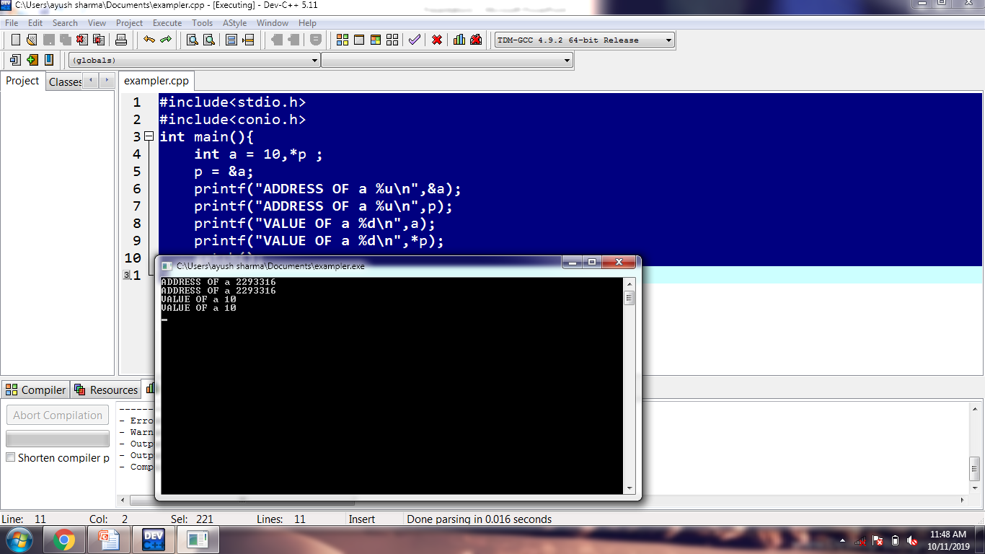
Example to understand pointer operators:
//To print address of a particular variable using ‘*’ and ‘&’
#include<stdio.h>
#include<conio.h>
int main(){
int a = 10,*p ;
p = &a;
printf("ADDRESS OF a %u\n",&a);
printf("ADDRESS OF a %u\n",p);
printf("VALUE OF a %d\n",a);
printf("VALUE OF a %d\n",*p);
getch();
}
OUTPUT:

Slide 7
Pointers Arithmetic:
Two arithmetic operations on pointers are allowed: addition and subtraction.
In order to understand addition or subtraction,let A be an integer pointer variable with an address 2000 and also an integer takes 4 bytes of storage.After the expression A++,A contains 2002 not 2001 as A will point to the next integer.
Same thing happens in decrement.(A--)

Slide 8
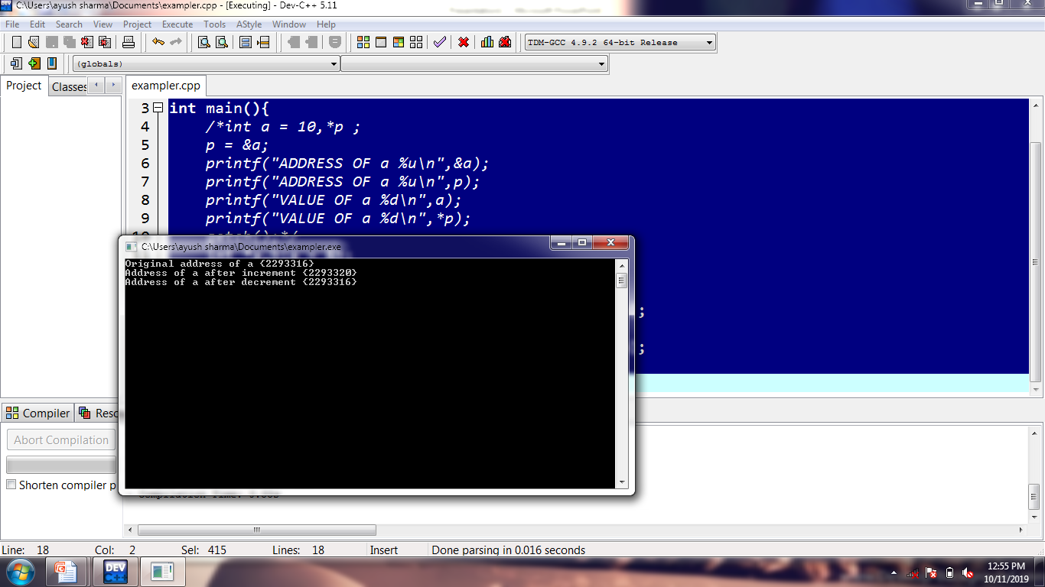
Example to Understand Pointer Arithmetic:
//Program to increment and decrement pointers
#include<stdio.h>
#include<conio.h>
int main(){
int *a,b;a = &b;
printf("Original address of a {%u}\n",a);
a++;
printf("Address of a after increment {%u}\n",a);
a--;
printf("Address of a after decrement {%u}\n",a);
getch();
}
OUTPUT:

Slide 9
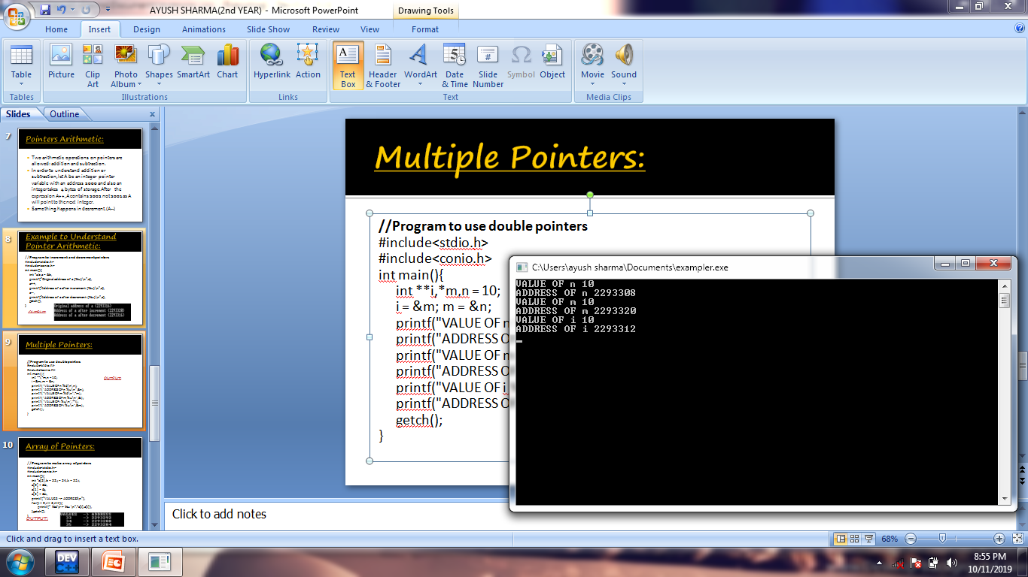
Multiple Pointers:
//Program to use double pointers
#include<stdio.h>
#include<conio.h>
int main(){
int **i,*m,n = 10;
i = &m; m = &n;
printf("VALUE OF n %d\n",n);
printf("ADDRESS OF n %u\n",&n);
printf("VALUE OF m %d\n",*m);
printf("ADDRESS OF m %u\n",&i);
printf("VALUE OF i %u\n",**i);
printf("ADDRESS OF i %u\n",&m);
getch();
}
OUTPUT:

Slide 10
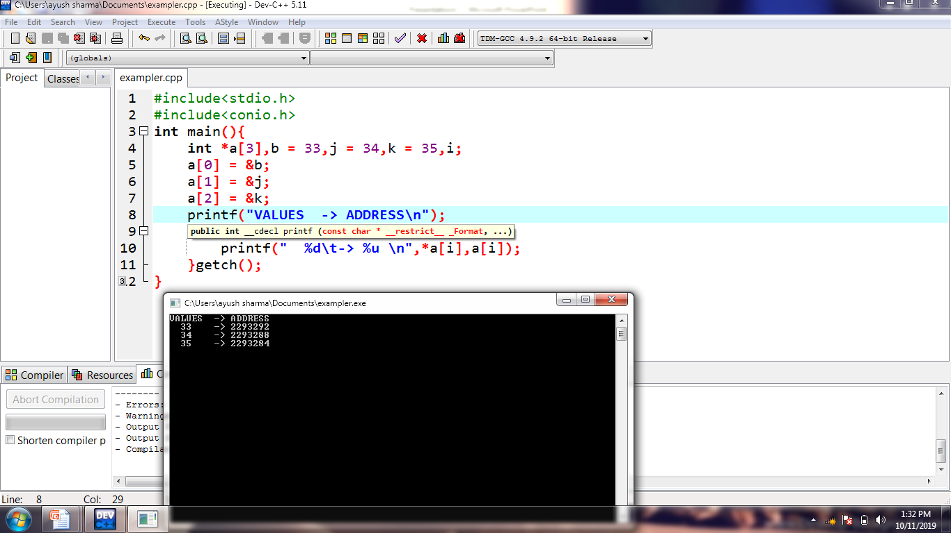
Array of Pointers:
//Program to make array of pointers
#include<stdio.h>
#include<conio.h>
int main(){
int *a[3],b = 33,j = 34,k = 35,i;
a[0] = &b;
a[1] = &j;
a[2] = &k;
printf("VALUES -> ADDRESS\n");
for(i = 0;i != 3;i++){
printf(" %d\t-> %u \n",*a[i],a[i]);
}getch();
}
OUTPUT:

Slide 11
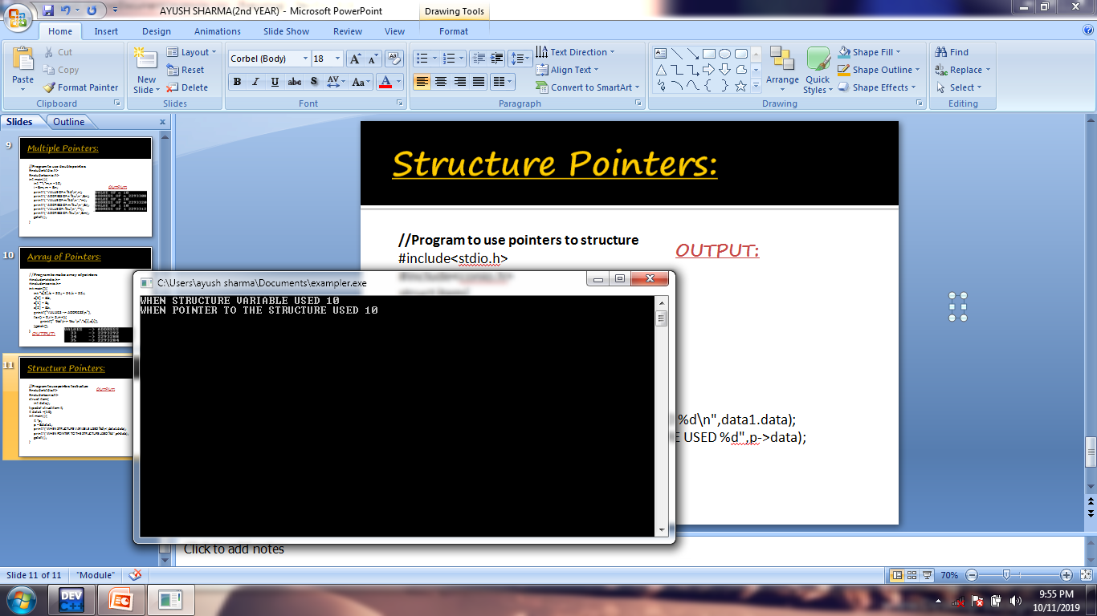
Structure Pointers:
//Program to use pointers to structure
#include<stdio.h>
#include<conio.h>
struct item{
int data;};
typedef struct item It;
It data1 ={10};
int main(){
It *p;
p = &data1;
printf("WHEN STRUCTURE VARIABLE USED %d\n",data1.data);
printf("WHEN POINTER TO THE STRUCTURE USED %d",p->data);
getch();
}
OUTPUT:

Slide 12
THANK YOU EVERYONE.☺ ALL QUERIES WILL BE APPRECIATED. ☺☺

